Slide 1
Computation of matrix functions with fully automatic Schur-Parlett and Rational Krylov methods.
Roberto Zanotto | PD2GGALN 2018

Slide 2
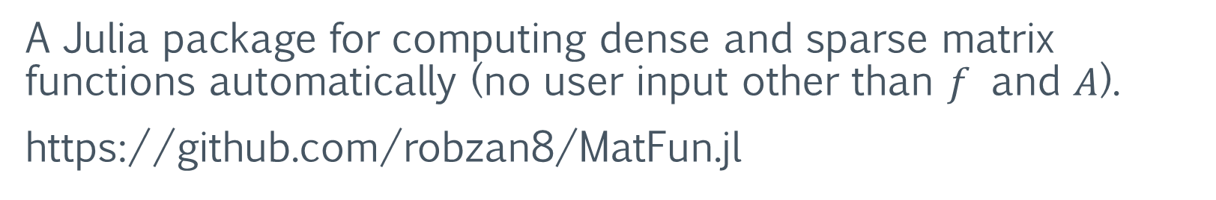
About me
Computer Science student at the University of Pisa.
Master’s degree thesis under supervision of professor Federico Poloni.
MatFun
A Julia package for computing dense and sparse matrix functions automatically (no user input other than $f$ and $A$).
https://github.com/robzan8/MatFun.jl

Slide 3
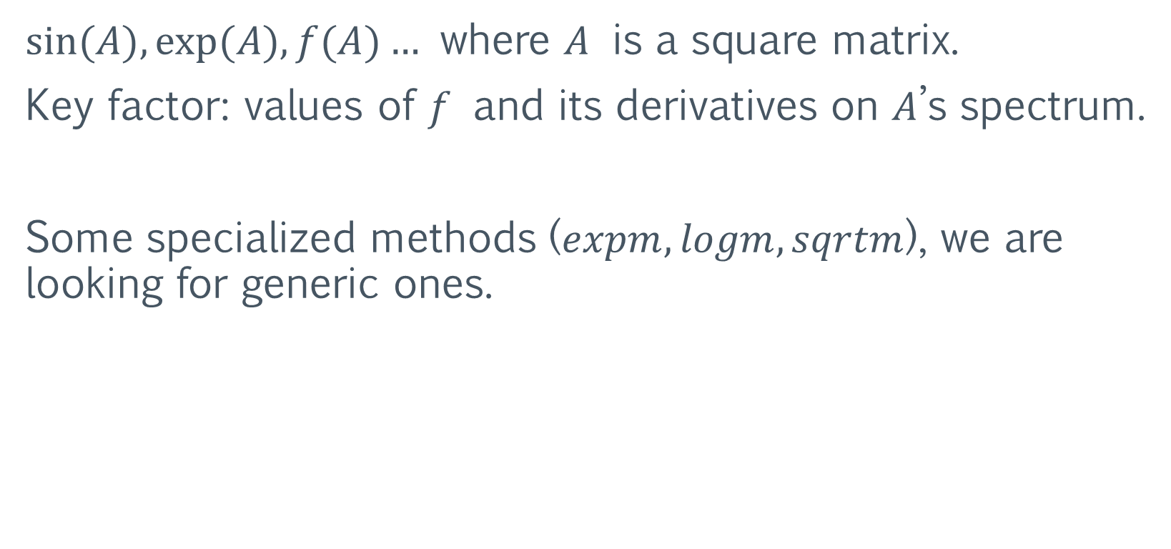
Matrix Functions
$sin⁡(A), exp⁡(A), f(A)…$ where $A$ is a square matrix.
Key factor: values of $f$ and its derivatives on $A$’s spectrum.
Some specialized methods ($expm, logm, sqrtm$), we are looking for generic ones.

Slide 4
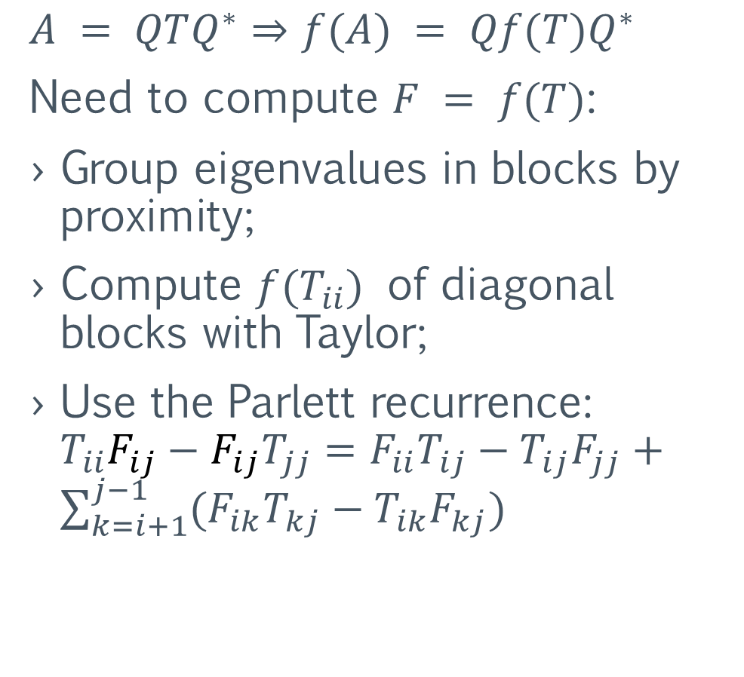
Schur-Parlett – dense matrix functions
$$A = QTQ^{∗}⇒f(A) = Qf(T)Q^{∗}$$
Need to compute $F = f(T)$:
Group eigenvalues in blocks by proximity;
Compute $f(T_{ii})$ of diagonal blocks with Taylor;
Use the Parlett recurrence: $T_{ii}F_{ij}−F_{ij}T_{jj}=F_{ii}T_{ij}−T_{ij}F_{jj}+\sum_{k=i+1}^{j−1}{(F_{ik}T_{kj}−T_{ik}F_{kj})}$

Slide 5
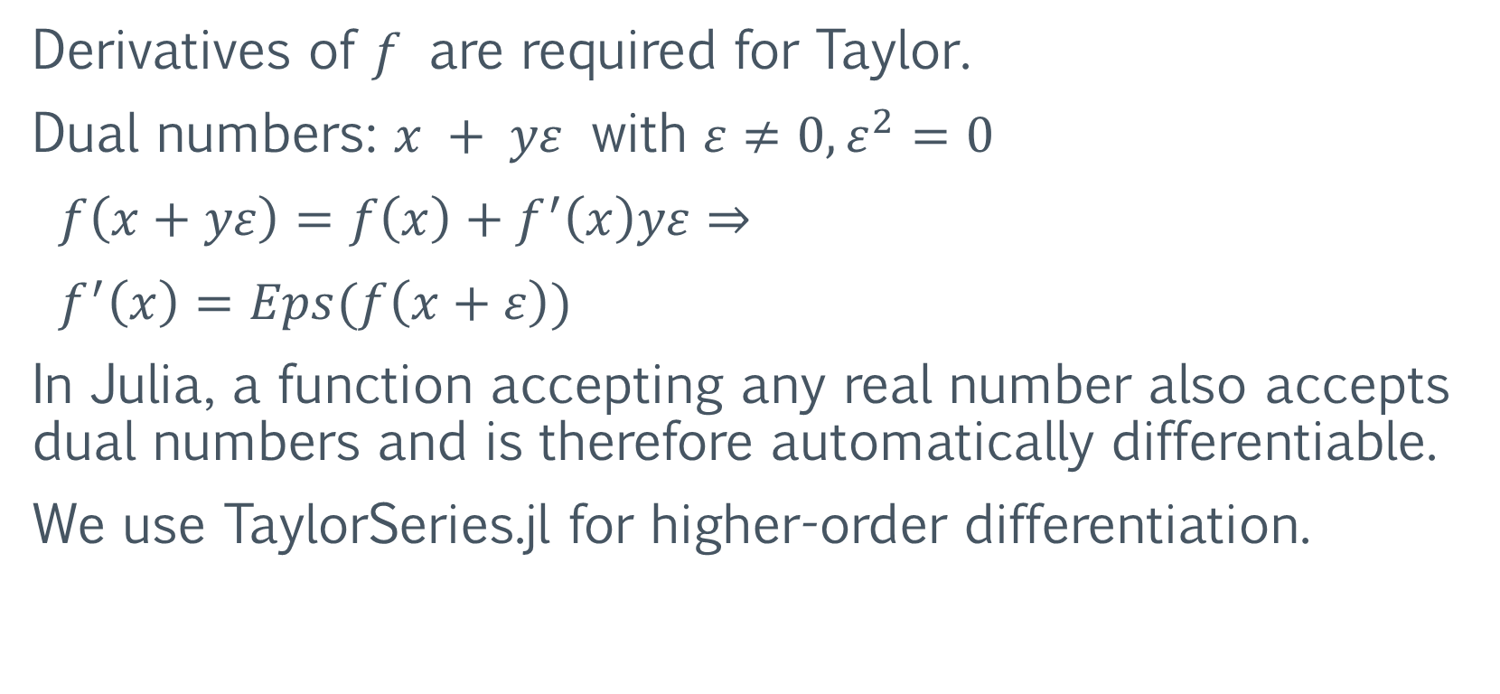
Schur-Parlett – automatic differentiation
Derivatives of $f$ are required for Taylor.
Dual numbers: $x + yε$ with $ε≠0, ε^{2}=0$
$f\left(x+yε\right)=f\left(x\right)+f^{′}\left(x\right)yε⇒$
$f^{′}\left(x\right)=Eps(f\left(x+ε\right))$
In Julia, a function accepting any real number also accepts dual numbers and is therefore automatically differentiable.
We use TaylorSeries.jl for higher-order differentiation.

Slide 6
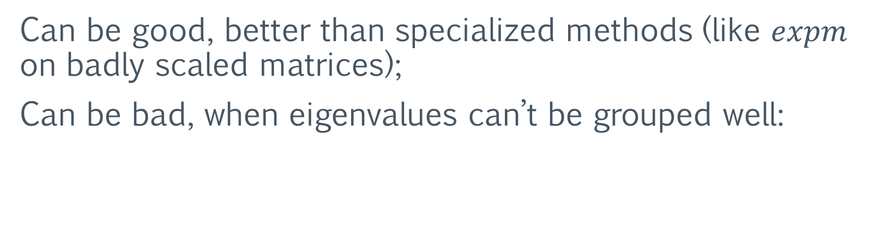
Schur-Parlett – numerical accuracy
Can be good, better than specialized methods (like $expm$ on badly scaled matrices);
Can be bad, when eigenvalues can’t be grouped well:

Slide 7

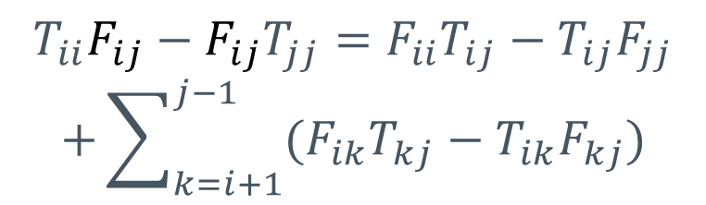
Schur-Parlett – performance improvements
Parlett recurrence made recursive and cache-oblivious.
$$⇒$$
$$T_{ii}F_{ij}−F_{ij}T_{jj}=F_{ii}T_{ij}−T_{ij}F_{jj}$$
$$+\sum_{k=i+1}^{j−1}{(F_{ik}T_{kj}−T_{ik}F_{kj})}$$
$$T_{11}F_{12}−F_{12}T_{22}=F_{11}T_{12}−T_{12}F_{22}$$
~3x speedup for n = 2500

Slide 8


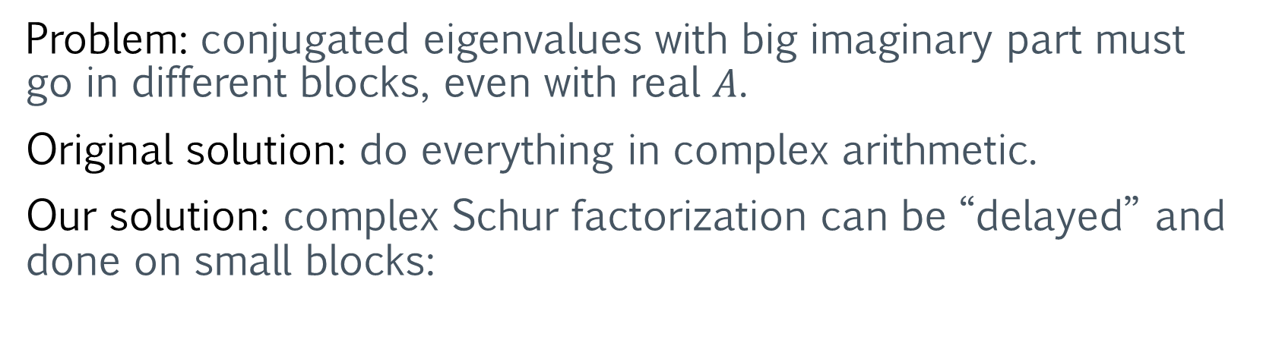
Problem: conjugated eigenvalues with big imaginary part must go in different blocks, even with real $A$.
Original solution: do everything in complex arithmetic.
Our solution: complex Schur factorization can be “delayed” and done on small blocks:
small
complex
Schur
real
Schur
$$⇒$$
$$⇒$$
Also allows for Parlett recurrence with real Sylvester equations, ~2x speedup for n = 2500 on whole Schur-Parlett.

Slide 9

Schur-Parlett – performance results
The whole procedure typically spends ~2/3 of the time doing $A$’s Schur decomposition (varies depending on the eigenvalues’ distribution).

Slide 11
Two Content Layout with Table
Class | Group A | Group B
Class 1 | 82 | 95
Class 2 | 76 | 88
Class 3 | 84 | 90
First bullet point here
Second bullet point here
Third bullet point here

Slide 12
Two Content Layout with SmartArt
A
Task 1
Task 2
B
Task 1
Task 2
C
Task 1
Task 2
First bullet point here
Second bullet point here
Third bullet point here

Slide 13
Add a Slide Title - 1

Slide 14
Add a Slide Title - 2

